Slide 1
JavaScript Task Runners for the ASP.NET Developer
September 8, 2015
WI .NET Users Group

Slide 2





About me and this talk
Scott Addie
.NET Solutions Architect
MCSD (Web Apps)
Visual Studio Code Insider
GitHub.com/scottaddie/mvc-task-runners
ScottAddie.com
@Scott_Addie
LinkedIn.com/in/scottaddie

Slide 3

What is a task runner?
Think of it as MSBuild for JavaScript
Benefits:
Automates repetitive tasks
Enforces build consistency
Improves development workflow quality
Develop → Analyze → Test → Package → Deploy

Slide 4
Common responsibilities of task runners
Transpiling JS (TypeScript, Babel, etc.)
Transforming JS (bundling modules, ng-annotate, etc.)
Bundling files
Minifying files
Generating JS source maps
Preprocessing CSS (LESS, SASS, Stylus, etc.)
Transforming CSS (e.g., AutoPrefixer)
Busting the cache
Optimizing images
Copying files
Watching files for changes
Running unit tests
Analyzing code (e.g., linting)

Slide 5

If I have to remember, I’m going to forget

Slide 6
Why to use one with ASP.NET
3 Compelling Reasons

Slide 7

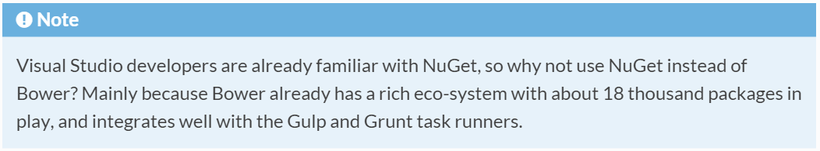
1. NuGet has been demoted
Open-source contributors neglect NuGet
Use Bower or NPM for client-side assets
Bower used for MVC 6’s unobtrusive JS
From the ASP.NET docs:
http://bit.ly/1lGF3s2

Slide 8
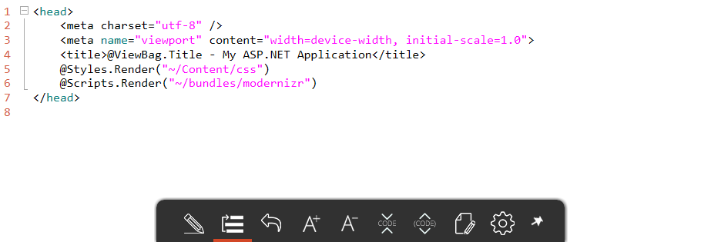
2. ASP.NET Bundling & Minification is obsolete
http://bit.ly/1KEc29U

Slide 9
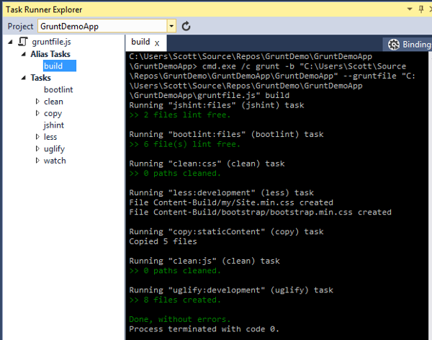
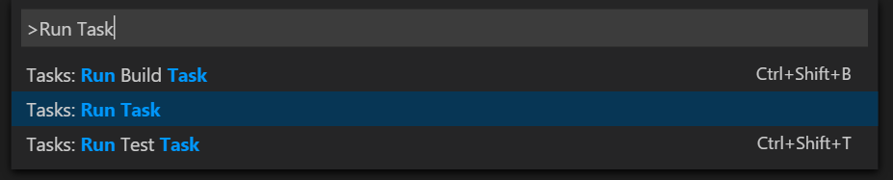
3. Command Palette & Task Runner Explorer make it easy
No need to use command line
Bind tasks to VS events

Slide 10

Which task runner should I use?
A task runner showdown

Slide 11


Files vs. Streams
Diagrams based on John Papa’s Pluralsight course

Slide 12
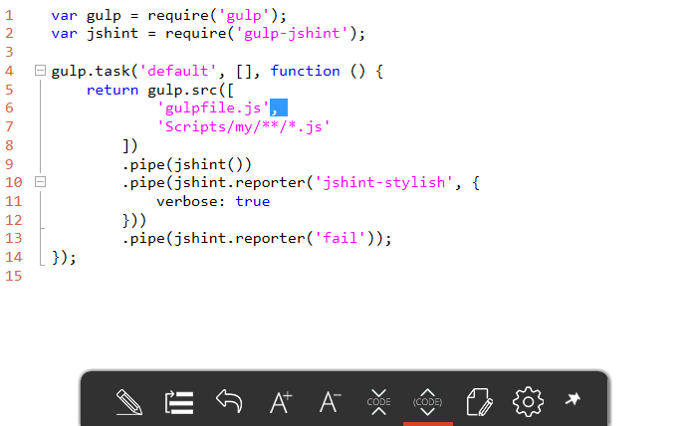
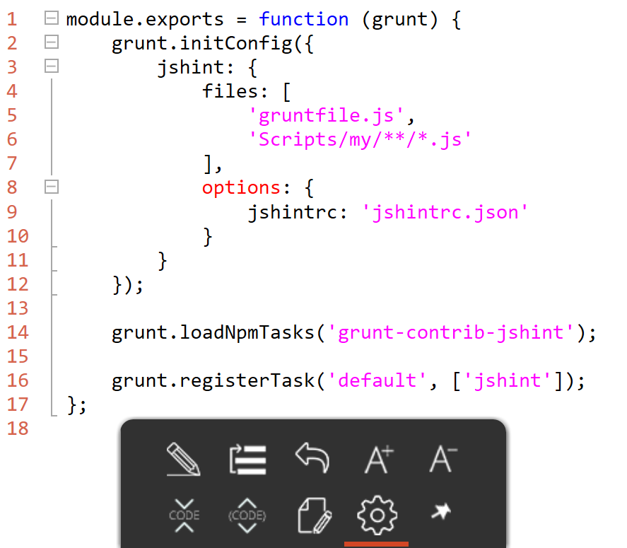
Configuration vs. Code
gruntfile.js
gulpfile.js

Slide 13
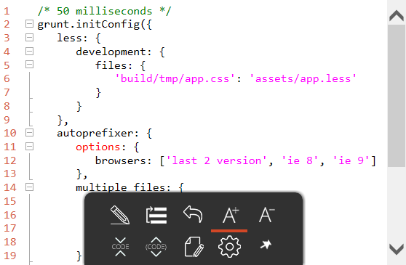
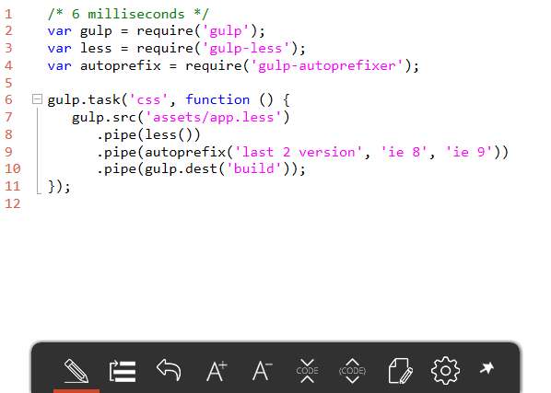
Performance comparison Processing 1 small LESS file
gruntfile.js
gulpfile.js
http://bit.ly/1oUxzhL

Slide 14
Dashboard view
GitHub Contributors | 55 | 146
GitHub Stars | 9,927 | 15,923
Plugins | 5,095 | 1,789
Creator | Bocoup | Fractal
Inception | March 2012 | July 2013
ASP.NET 5 Default |  | X

Slide 15



Tweets from thought leaders How do I choose?

Slide 16
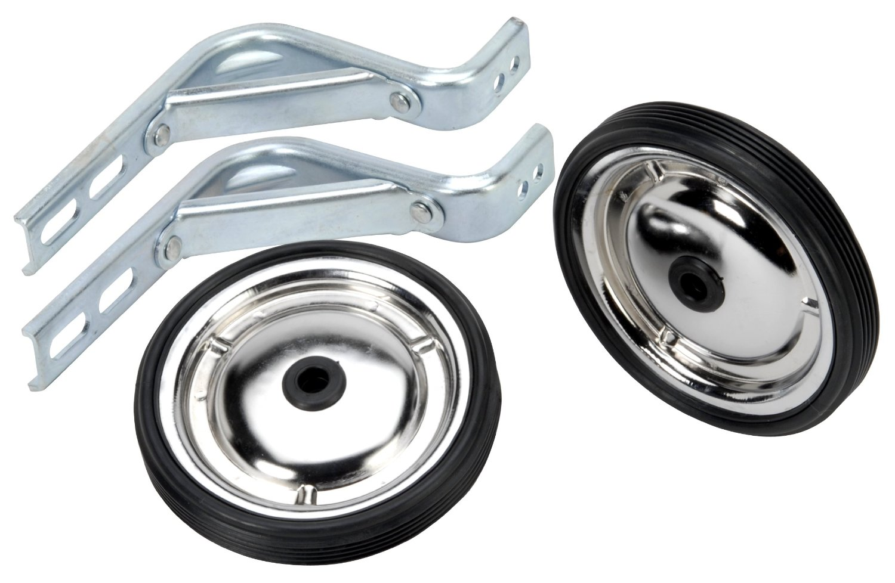

Grunt needs training wheels
More readily use native Node modules w/ Gulp

Slide 17
Debugging Grunt tasks is frustrating

Slide 18

…and the verdict is

Slide 19

How to use Gulp in your project
5 Easy Steps

Slide 20
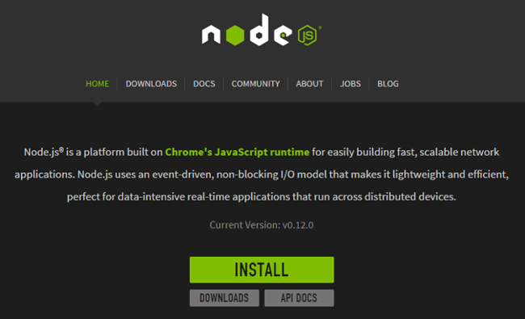

Prerequisites Node.js & NPM (Node Package Manager)
Install via nodejs.org:
…or via chocolatey.org:
PS:\>iex ((new-object net.webclient).DownloadString('https://chocolatey.org/install.ps1'))
PS:\>choco install nodejs.install

Slide 21
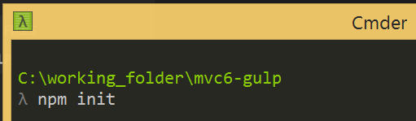
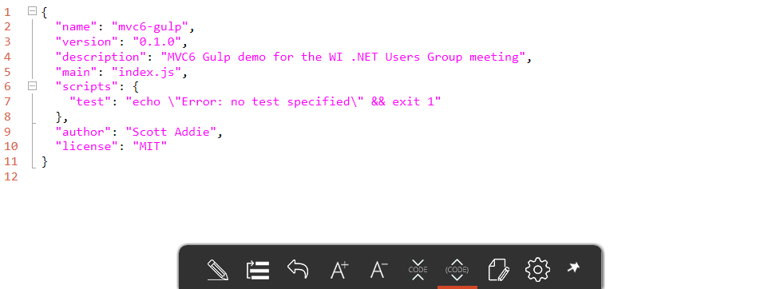
1. Create package.json file

Slide 22
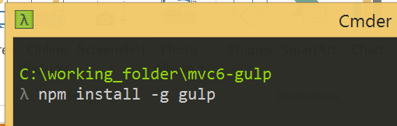
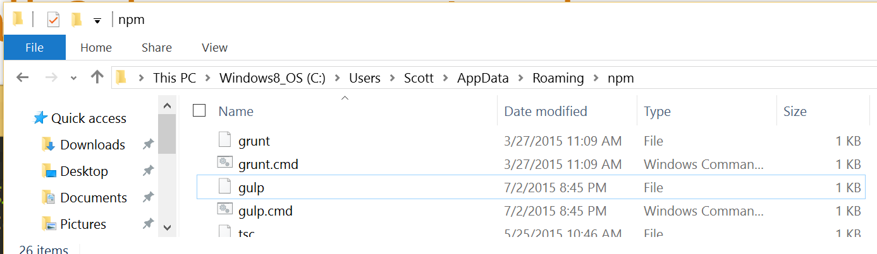
2. Install Gulp at system Level

Slide 23
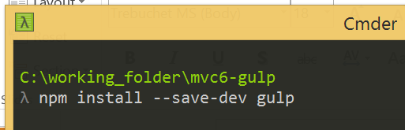
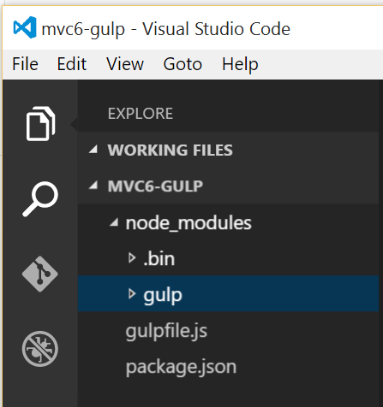
3. Install Gulp locally

Slide 24
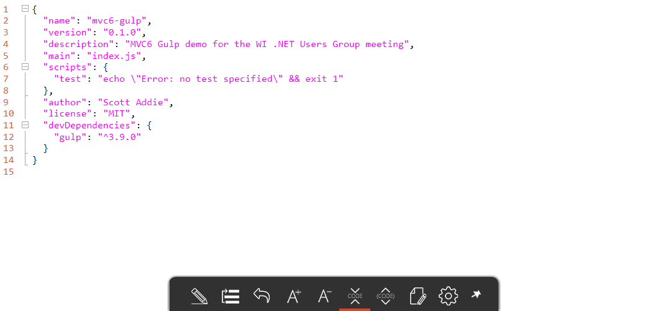
3. Install Gulp locally (cont.)

Slide 25
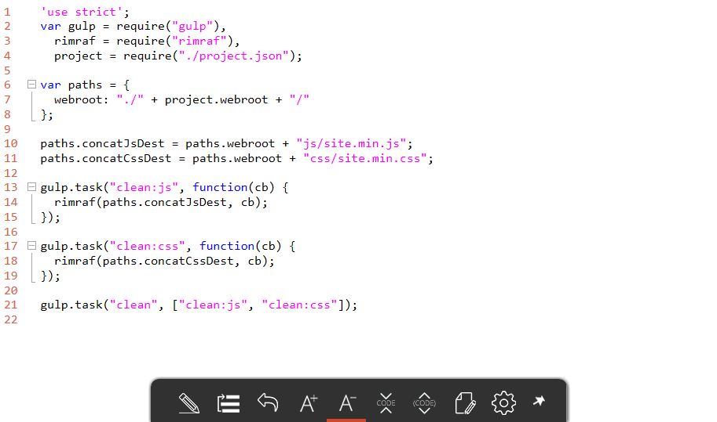
4. Create gulpfile.js

Slide 26
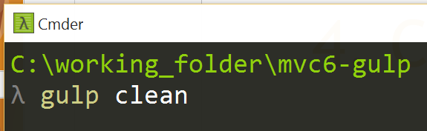
5. Run Gulp task

Slide 27


Demo
let demo = + ( || );
Using Gulp w/ ASP.NET 5 in VS Code or VS 2015

Slide 28

Resources
Scan QR for slides & code:
Official Gulp website
JavaScript Build Automation with Gulp.js
John Papa, Pluralsight course
Gulp and Grunt at Anglebrackets
John Papa, blog post

